Slide 1

Central Govt of India Indian Water Bodies Analysis
Dataset Name :State-wise data of first census of water bodies - Andaman and Nicobar islands

Slide 2
The dataset provides comprehensive information on water bodies across various regions in India, covering 3,527 records with 55 attributes related to location, ownership, usage, storage capacity, and administrative policies. It includes geographic details such as state, district, village, latitude, and longitude, along with classification into rural and urban areas.
The below slide contains info of the dataset.

Slide 3
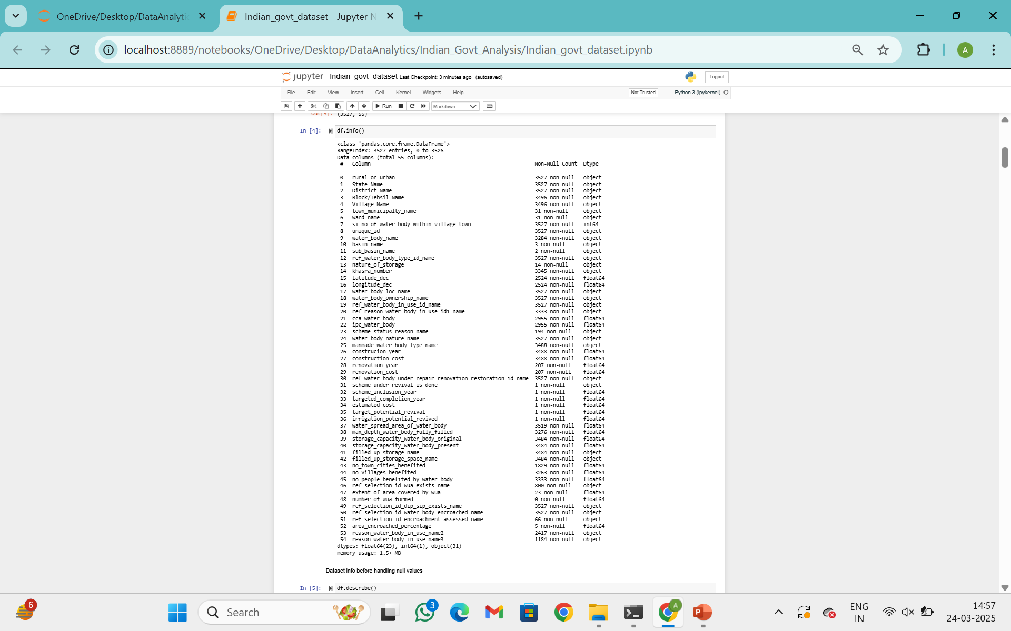

Slide 4
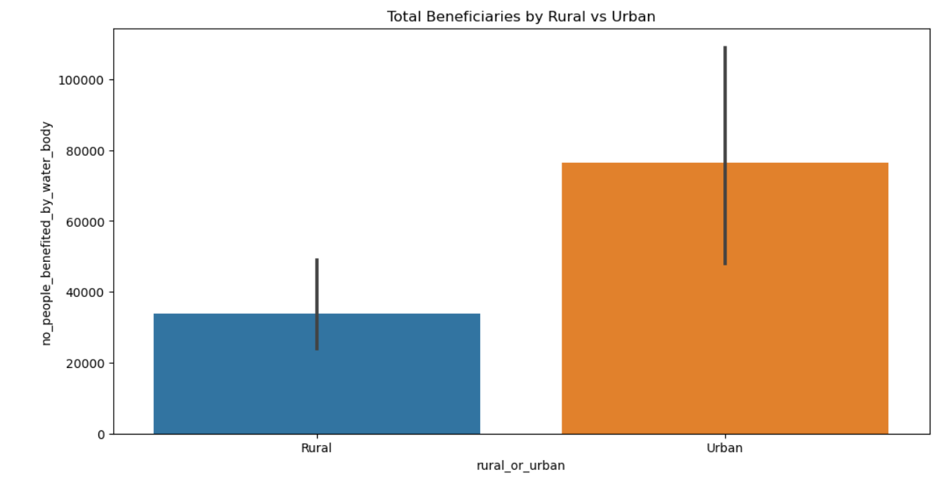
The above bargraph clearly represents that the urban areas people gets more benefits than the rural areas people.

Slide 5
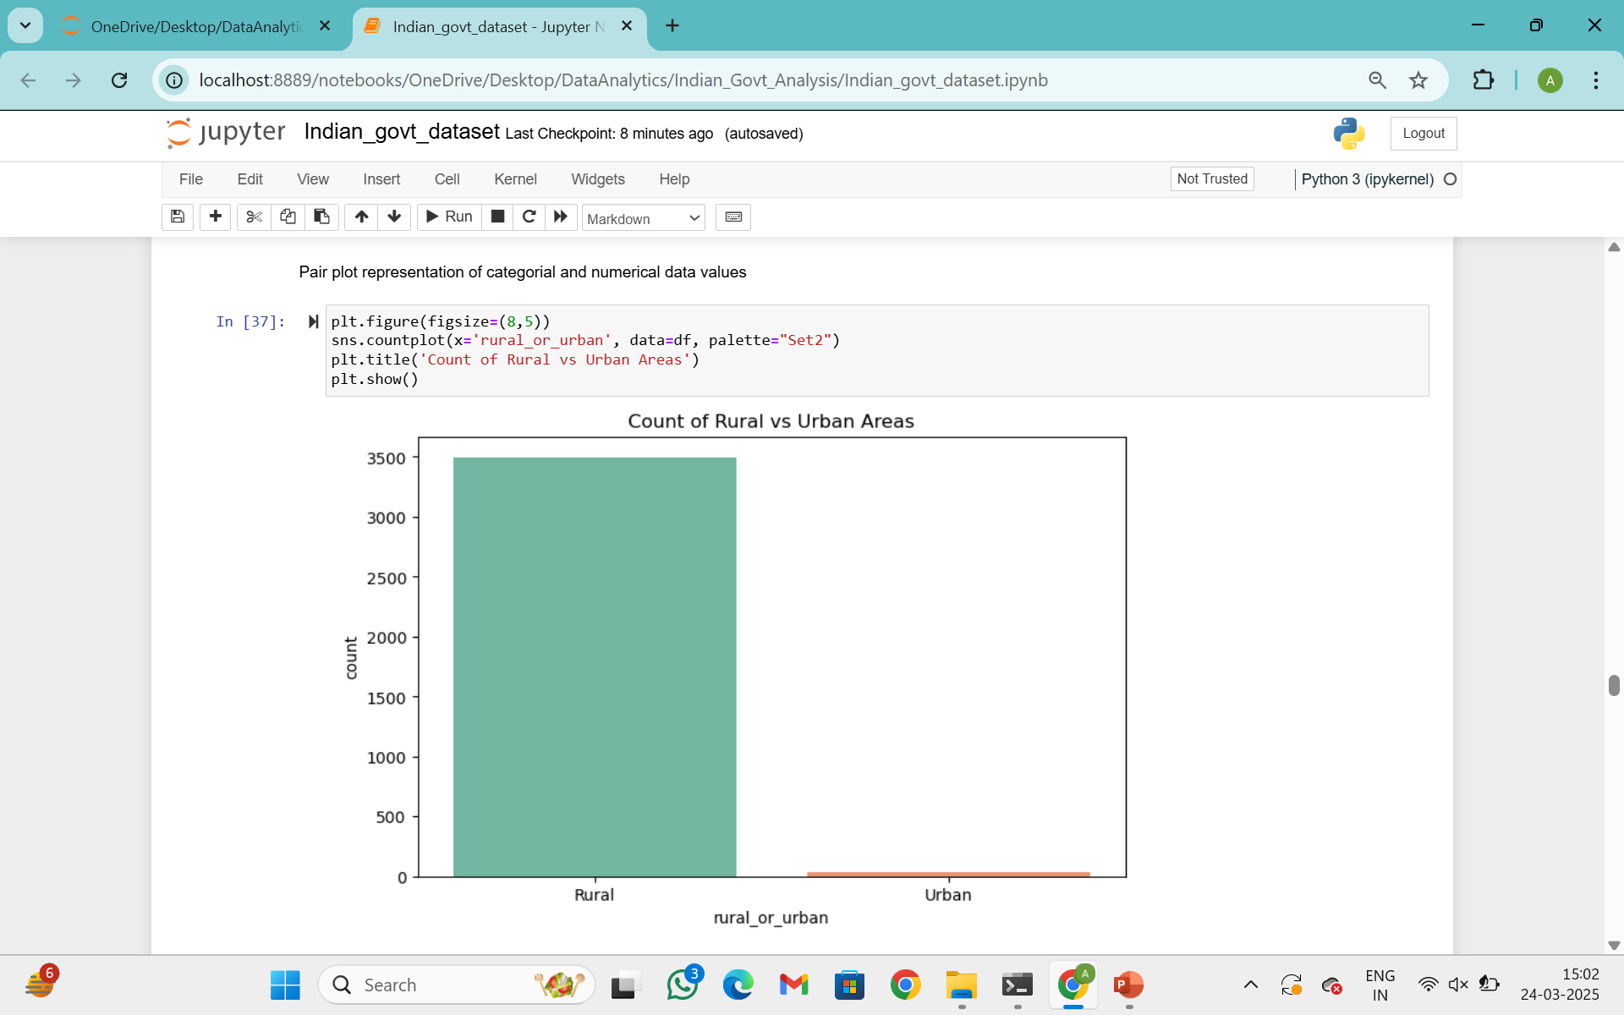
People count is more in rural areas when compared to urban areas but the issue raises due to high population

Slide 6
Observation from dataset:-
The analysis indicates that water bodies play a crucial role in sustaining urban and rural communities, but many are underutilized or facing encroachment issues. Proper restoration, monitoring, and policy interventions are necessary to enhance water conservation efforts.
It highlights water body usage for irrigation and other purposes

